Slide 1
MPEA db figures
Bryce Meredig, Chief Scientist
James Saal, Manager of External Research Programs
Chris Borg, Research Scientist
Tresa Pollock, ALCOA Distinguished Professor
Anton Van der Ven, Professor, Materials
Carolina Frey, graduate student researcher
12 Feb 2020
Robert O. Richie, H. T. & Jessie Chua Distinguished Professor of Engineering
Jon Ell, PhD student
Daniel B. Miracle, Acting Chief Scientist in the Air Force Office of Scientific Research (AFOSR)

Slide 2
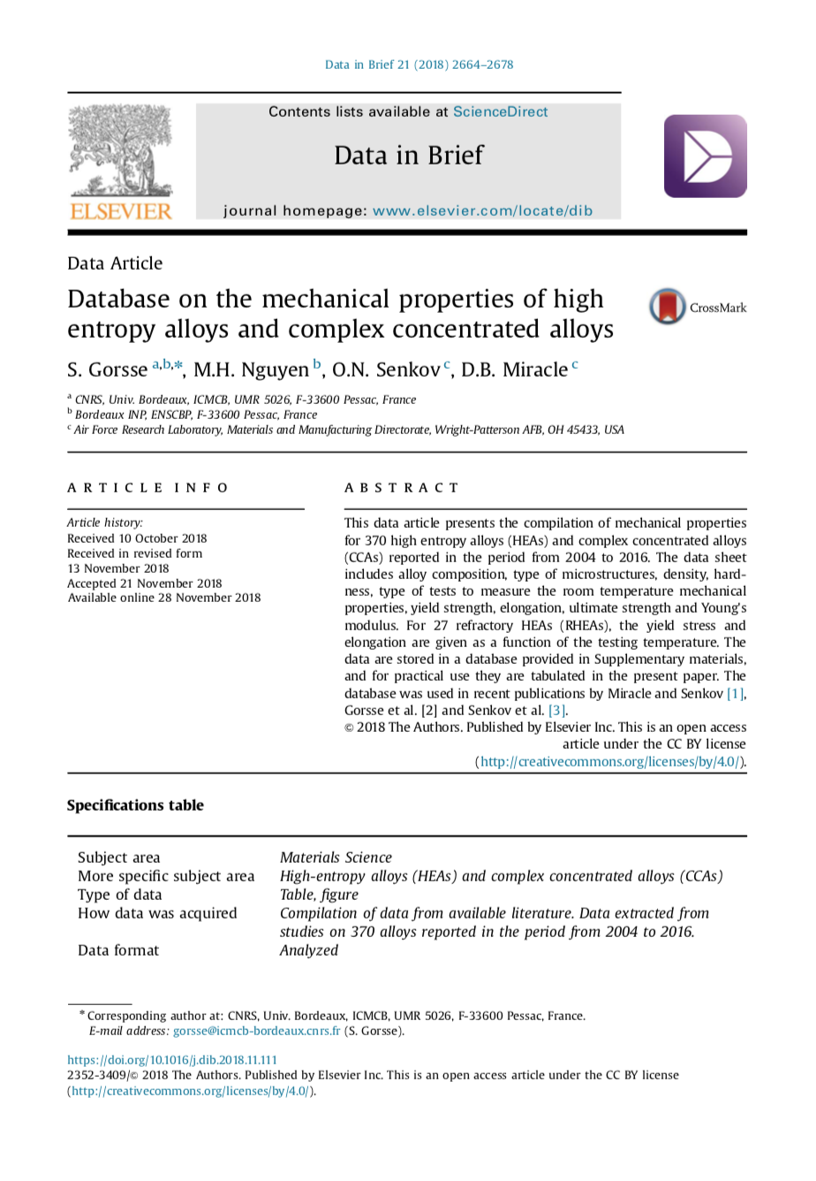
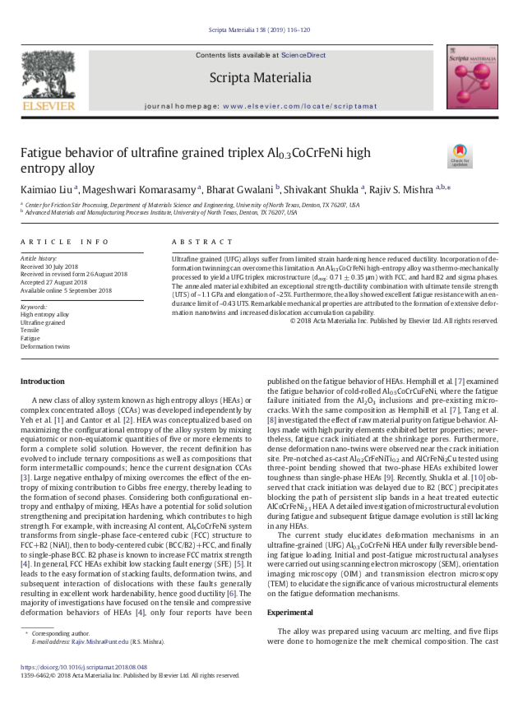
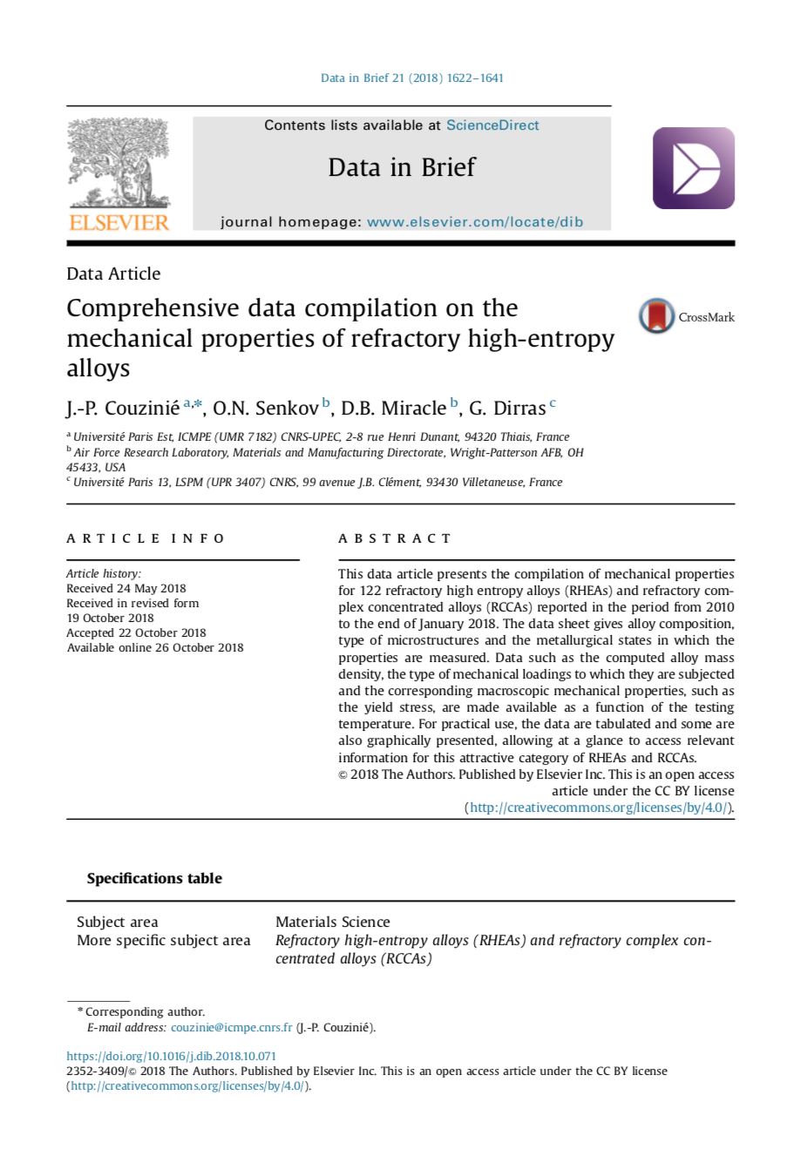
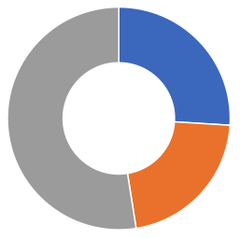
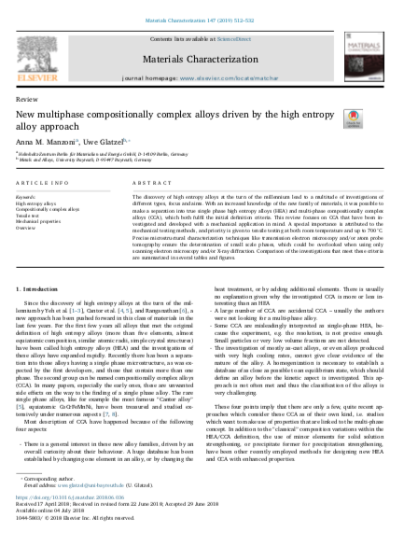
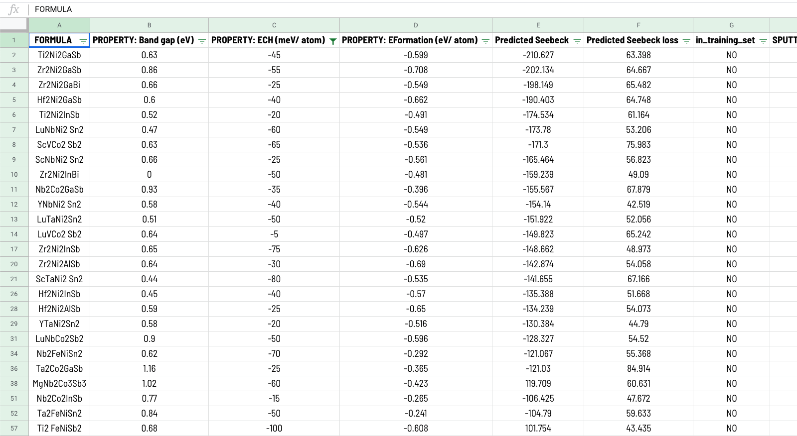
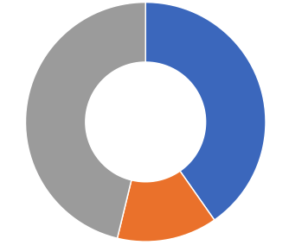
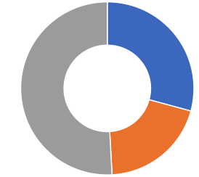
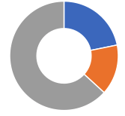
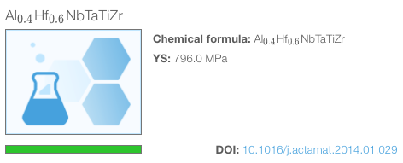
Db workflow
Structured data template
Yield strength
Elongation
other
BCC
641
1067
Ultimate strength
FCC
Hardness
Relevant articles published since 2004. (200+)
543
536
100s of mechanical properties
Web-based data infrastructure
New MPEA publication

Slide 3
YS scatterplot

Slide 4
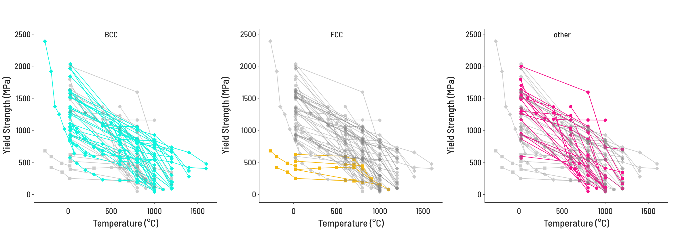
YS temperature

Slide 5
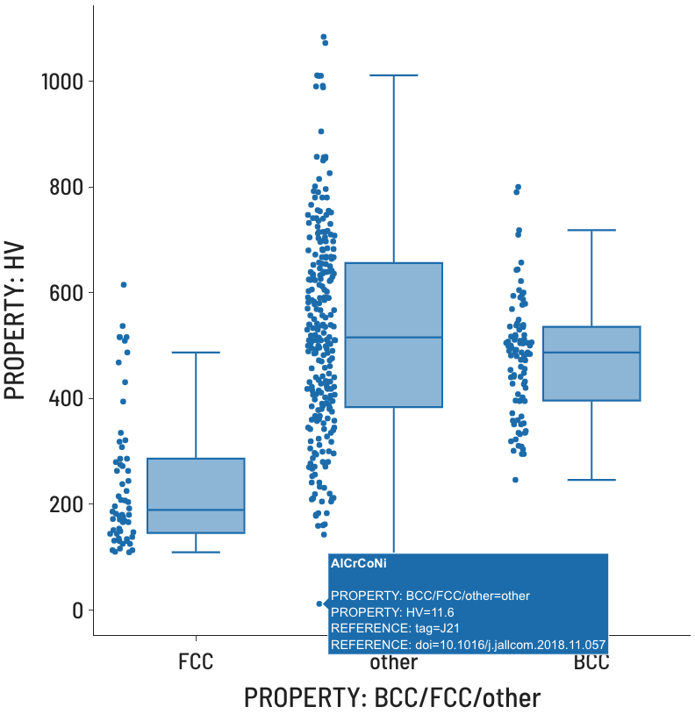
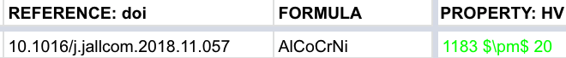
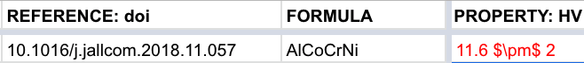
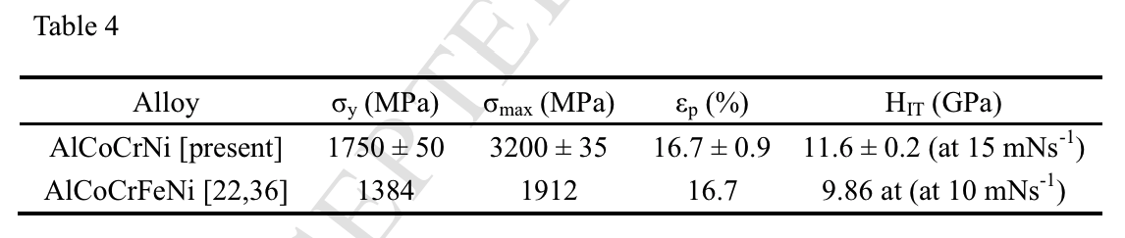
Outlier detection
3
Correct inaccuracy
2
Identify inaccuracy type
Identify source
1

Slide 6
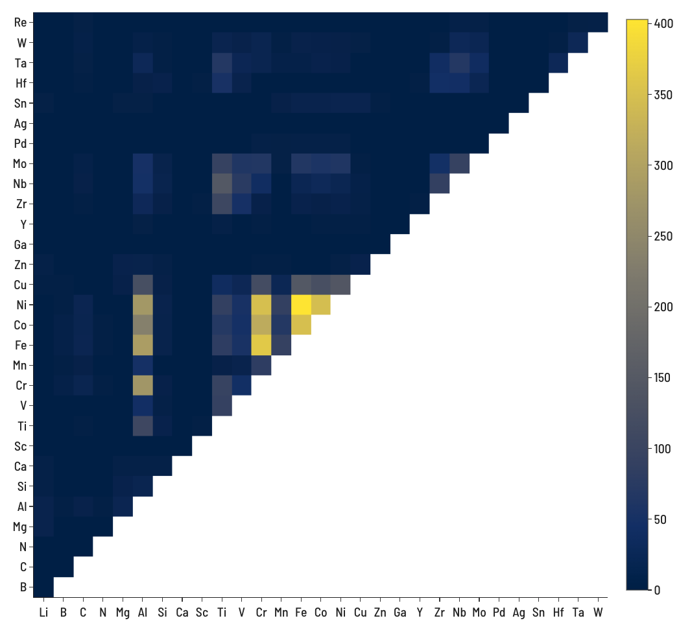
Number of records containing both elements
4-element (ABCD) systems = 27,405
5-element (ABCDE) systems = 142,506

